Slide 1
CALCULATOR USING GITHUB
TEAM-
1. PRASHANT BHUNAL- HIMACHAL PRADESH
2. RAHUL THAKUR- HIMACHAL PRADESH
3. NAMAN JAIN- DELHI

Slide 2

GIT HUB

Slide 3
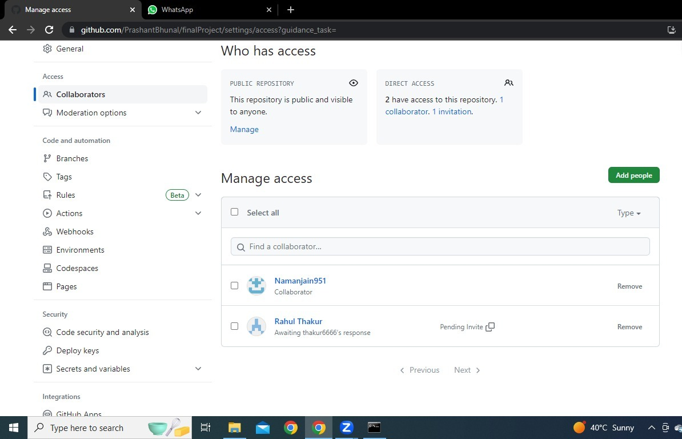
SHARING OF FILES
COLLABORATION FEATURES OF GIT HUB

Slide 4
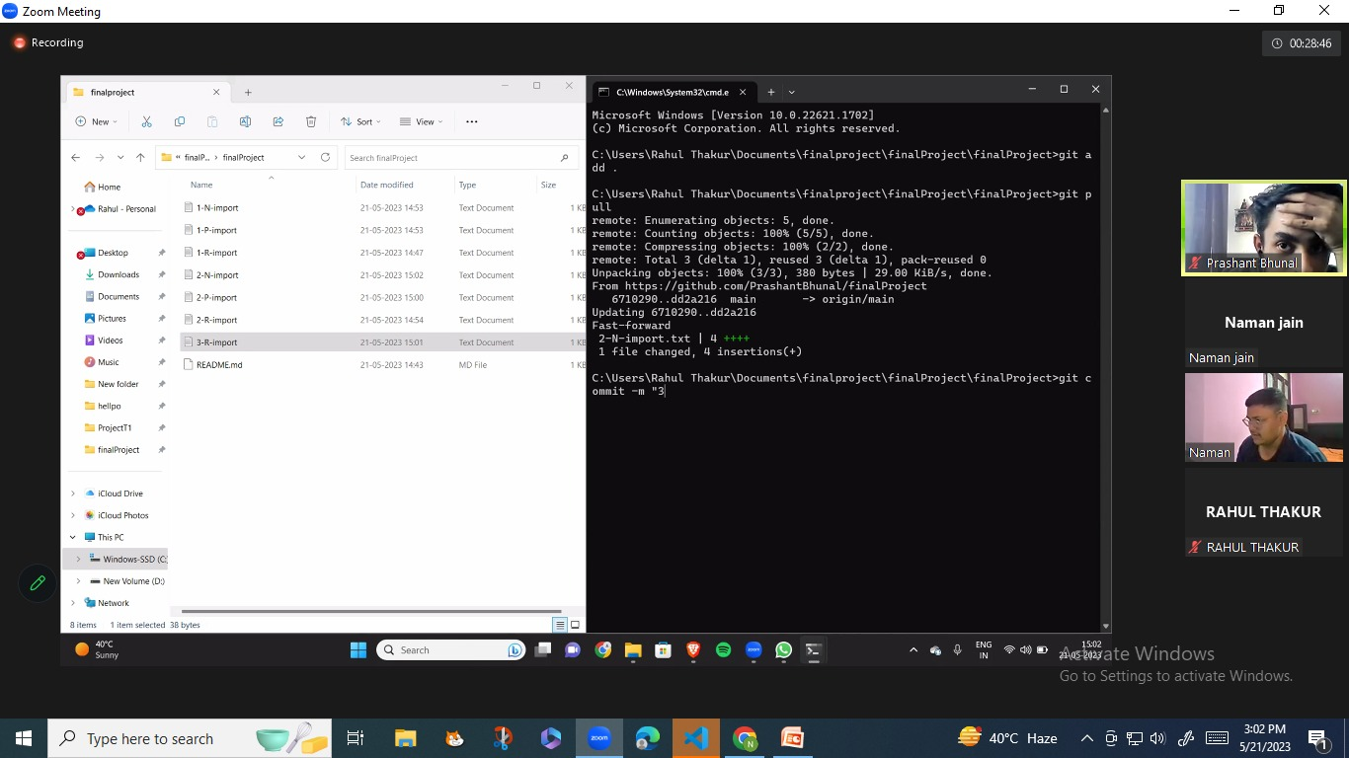
Exchanging Of Codes

Slide 5
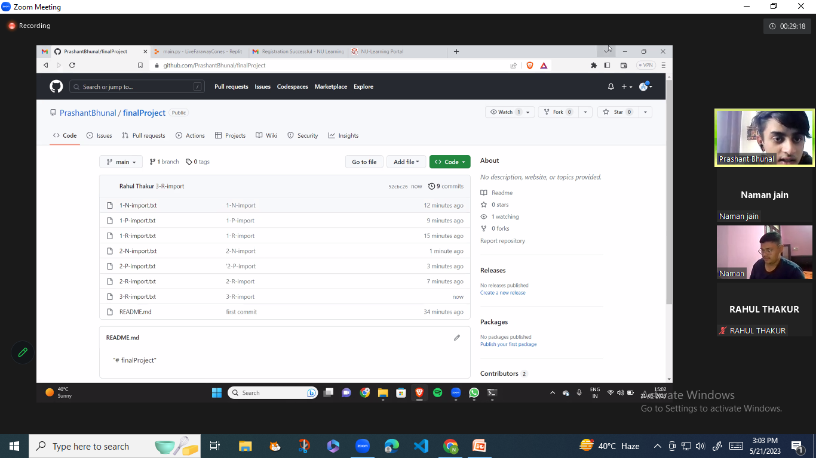

Slide 6
Using Of Commands
Git clone – For Cloning The Repository in other machines
Git add . – For adding a file in local repository
Git commit – For committing the added file
Git push – For uploading the file from local repository to master repository
Git pull – For Extracting the files to the machines.
Git status – For viewing the status of files in repository

Slide 7
Use Of Git Push And Git Pull
Git Push
Git Pull
For uploading the file from local repository to master repository.
For Extracting the files to the machines.

Slide 8
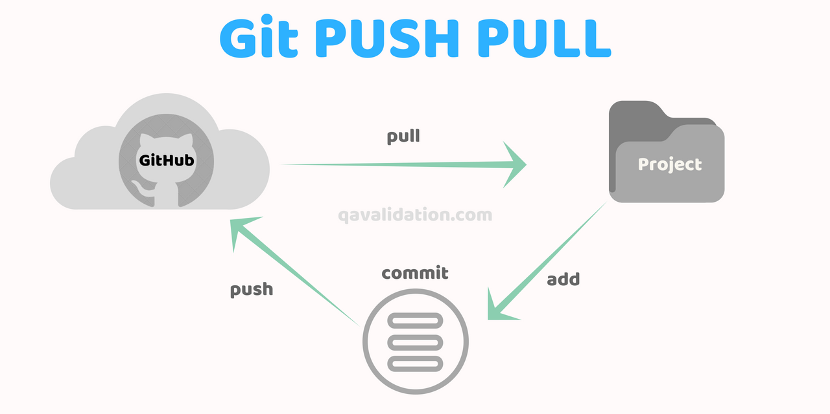

Slide 9
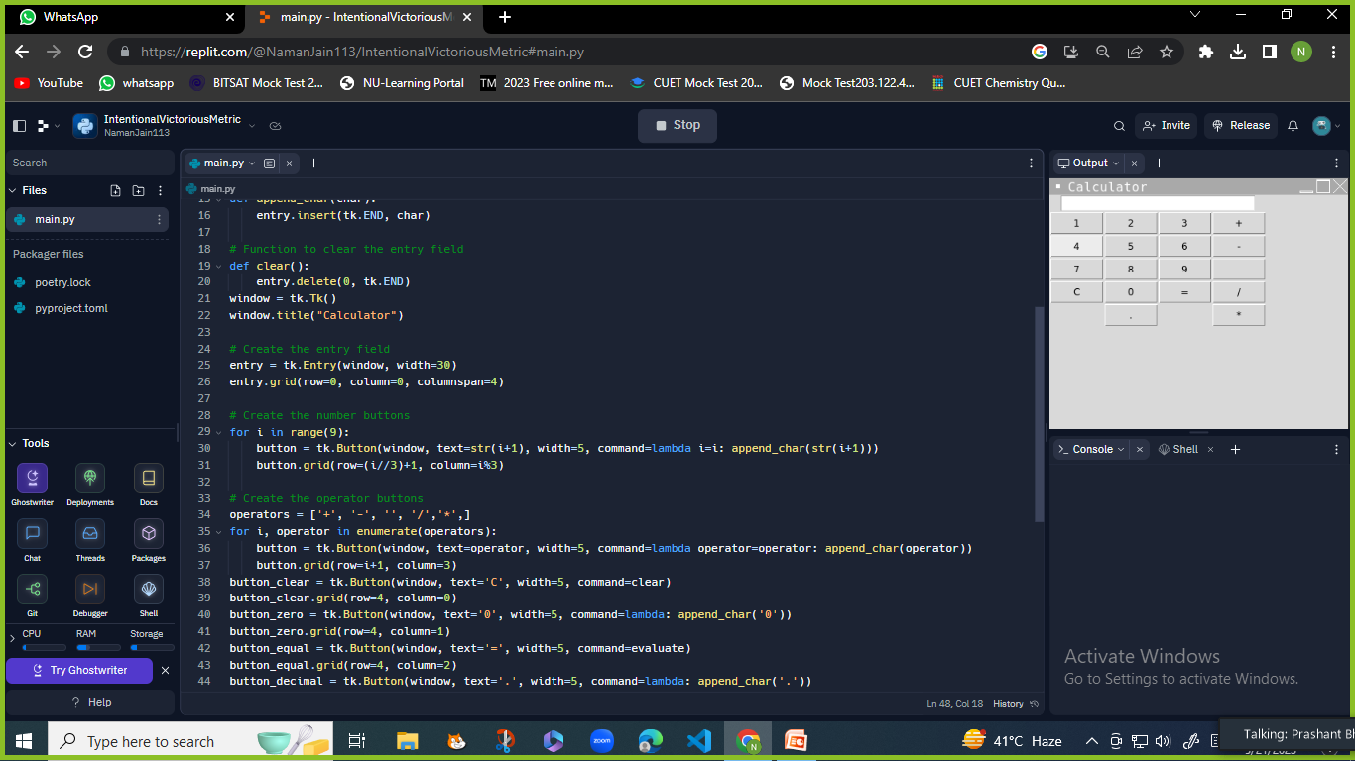
Python Codes For Calculator
**

Slide 10

Use Of Code Editor

Slide 11
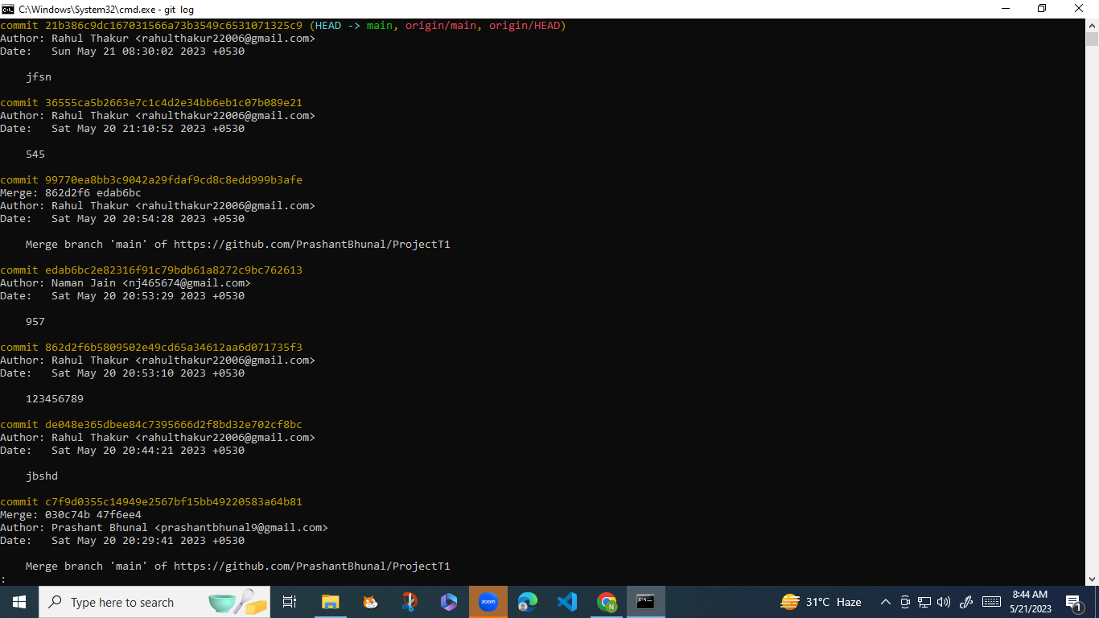
How To Use Checkout And Log Command

Slide 12
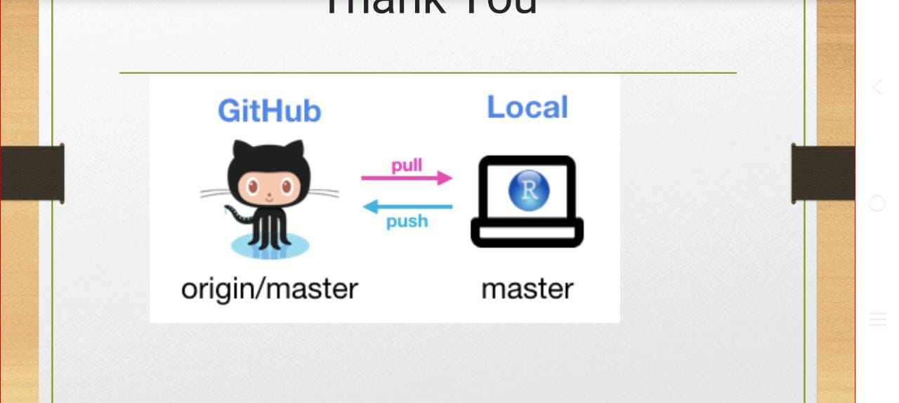
Thank You NIIT UNIVERSITY

